Slide 1
REAL ANALYSIS-I
BY
L.HENRY
ASSISTANT PROFESSOR
DEPT OF MATHEMATICS
PERIYAR ARTS COLLEGE,CUDDALORE

Slide 2
1.3FUNCTIONS
Definition1:Cartesian product
If A,B are sets,then the Cartesian product of A and B(denoted A X B )is the set of all ordered pairs < a,b> where a∈A, b∈B with the property that each a∈A belongs to precisely one pair <a,b> ,where b=f(a) and b is called image of ‘a’ under the function f, The set A is called the domain of f. the range of f is the set {b∈B / b=f(a) for some a∈A }.That is,the range of f is the subset of B consisting of all images of elements of A. Such function is sometimes called a mapping of A into B.
Example:
The function f:R→R,defined by f(x)=x² where R is the set (-∞ , ∞ ) that is f(2)=4,f(-2)=4, f(3)=9 f(1)=1 etc

Slide 3
Definition2 :Onto function
IF ‘ f ’ is a function from A into B, we write f:A → B. If the range of f is all of B, We say that f is a function from A onto B. In this case sometimes write f : A ⇒ B.
example:
Let A={ 0, -1,1,-2,2,-3,3,-4,4,-5,5} and B={ 0,1,4,9,16,25} ,the function
f:A →B , defined by f(x)= x².here the range of f is all of B.
f(0)=0,f(1)=1,f(-1)=1,f(2)=4,f(-2)=4,f(3)=9,etc,therefore here every element of the set B is image of some element of the set A.Hence on to function.

Slide 4
1.4 Real –valued functions
Definition 3: f:A→R, here R is the set of all real numbers, the range of a given f is contained in the set of all real numbers,then we call f a real valued function.
Definition 4: If f:A→R and g:A→R, we define f+g as the function whose values at x∈A is equal to f(x) + g(x). That is (f+g)(x)= f(x) + g(x) (x∈A),
In set notation f + g = { < x, f(x) + g(x)> / x∈A },
Similerly,we define f – g and fg defined by,
(f-g)(x)= f(x) – g(x) (x∈A),
(fg)(x) = f(x)g(x) (x∈A),
Finally, if g(x) ≠0 for all x ∈A, we can define f/g by
(f/g)(x) = f(x)/g(x), (x ∈A). The sum,difference,product, and quotient of two real-valued functions with the same domain are again real-valued functions.

Slide 5
Definitions :
Defn:5 If f:A→R and c is a real number (c∈R), the function cf is defined by (cf)(x)=c[f(x)] (x∈A).
Defn:6 If f:A→R , g:A→R, then max(f,g) is the function defined by
max(f,g)(x) = max [ f(x),g(x) ] and min(f,g) = min [f(x),g(x) ] (x∈A)
Defn:7 If f:A→R, then IfI (modulus) is the function defined by
IfI(x) = If(x)I (x∈A).
If a , b are real numbers, the formula
max(a , b)=[Ia-bI +a +b]/ 2,
min(a , b)= [-Ia-bI + a + b]/2
max(f , g)= [If-g I +f +g]/2
min(f , g )= [-If-g I + f + g]/2 , for real –valued functions f and g .

Slide 6
Definition: one- to- one (or) 1-1 function
Defn:8If f:A →B,then f is called one-to-one (denoted 1-1) ,if f(x)=f(y) implies x=y (x,y ∈ A) (or) when x ≠ y,then f(x) ≠ f(y).
Example:
f:A → B, defined by f(x)= x², where A={ 0,1,2,3,4} and B={ 0,1,2,3,4,5,6,7,8,9,10,16}
Here, f(0)=0, f(1)=1,f(2)=4, f(3)= 9,f(4)=16.

Slide 7
1.5 Equivalence and countability
Defn:9 If f: A ⇒ B and f is 1-1,then f is called a 1-1 correspondence (between A and B ).If there exists a 1-1 correspondence between the sets A and B , then A and B are called equivalent.
Example: f:A → B ,defined by f(x)= x² and A={1,2,3,4,5} and B={ 1,4,9,16,25},
here f satisfies onto and 1-1 function conditions,therefore 1-1 correspondence function.

Slide 8
1.5 Equivalence and Countability
Defn:10 The set A is said to be countable if A is equivalent to the set I of positive integers.
Example:
Let f:I →A, where I=set of all positive integers ={1,2,3,4,……} and A=set of all integers {0,1,-1,2,-2,3,-3,...} the function defined by
f(n)=(n-1)/2, (n= 1,3,5,7,…….) and
f(n)=(-n)/2 , (n=2,4,6,8,………).Therefore the set A set of all integers is countable.
Theoritical definition of countable set: If every elements of a set A can be arranged by some mathematical order then the set A is countable.
Example: Z={ 0,1,-1,2,-2,3,-3,…….n,-n,……}
Example:A₁ ={a_{1 ,} a₂,a₃ ,..... a_{n ,........} } this set is countable,since we can lable the
Elements a₁ is the first term , a₂ is the second term,etc a_{n} is the n^{th} term of A₁ .

Slide 9
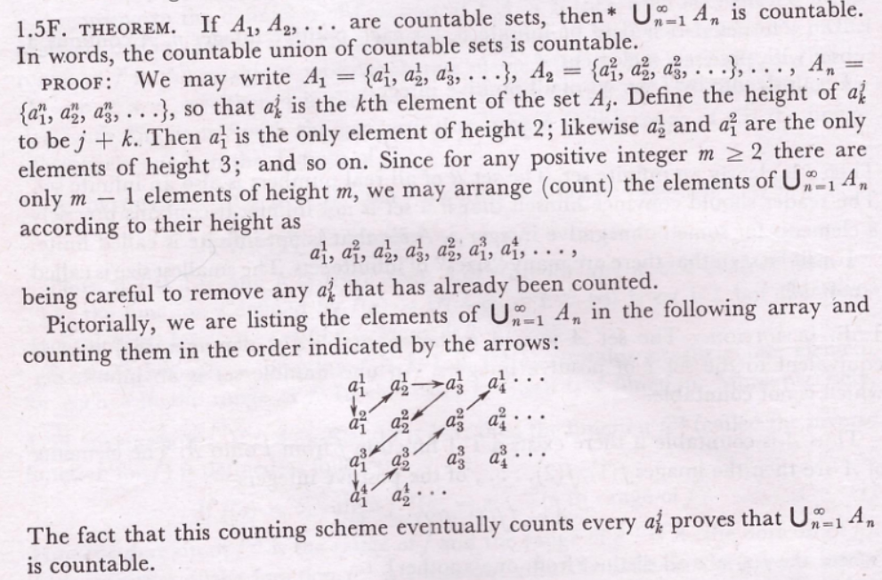

Slide 10
Definition11:
The set of all rational numbers denoted by Q = ∪_{n=1}∞ E_{n}
The set E_{n} ={ 0/n ,-1/n ,1/n ,-2/n ,2/n ,………… }
n=1set E₁ = { 0,-1,1,-2,2,…………………….}
n=2 set E₂= { 0, -1/2 ,1/2 ,-1 ,1,………… },etc
1.5G.corollary. The set of all rational numbers is countable.
Proof: The set of all rational numbers is the Q= ∪_{n}∞₌₁ E_{n} ,where E_{n} is the set of rationals which can be written with denominator n.That is,
E_{n} = { 0/n ,-1/n ,1/n ,-2/n ,2/n ,………………….},let us define a function f_{k} :I→ E_{k}
f_{k} (n)= { (1/k)[(n-1)/2] (n=1,3,5,…………..)
(1/k)[-n/2] (n=2,4,6,…………..)
Now, n=1 ,E₁ ={ 0,-1,1,-2,2,…………},the function is f₁:I→E₁
f₁ (n) = { [(n-1)/2]} (n=1,3,5,……………)
= {[-n/2] } (n=2,4,6,……………)
Therefore
f₁ (1)=0 , f₁ (2)=-1 , f₁ (3)=1 , f₁ (4)= -2,……….
Here every element of E₁ is image of some element of the set ‘ I’ therefore f₁ is onto function.
and different elements in ‘I’ have different images in E₁ ,therefore f₁ is 1-1 function.
By the definition E₁ is equivalent to I, therefore E₁ is countable set.
Similerly E₂ , E₃ , ......., E_{n} ,......... are countable sets ,using countable union of countable sets is countable, ∪_{n=1}∞ E_{n} is countable.
Therefore the set of rational numbers Q is countable.

Slide 11
1.5H.Theorem: If B is an infinite subset of the countable set A, then B is countable.(or) Prove that a subset of a countable is countable.
Proof: Let A ={a₁ , a₂ , a₃ ,........, a_{n} ,.......... }. Then each element of B is an a_{i} . Let n1 be the smallest subscript for which a_{n1} ∈B , let n2 be the next smallest , and so on.Then B= { a_{n1} , a_{n2} ,........... }.The elements of B are thus labelled with 1 , 2, 3 ,……..and so B is countable.
1.6:Real numbers

Slide 12
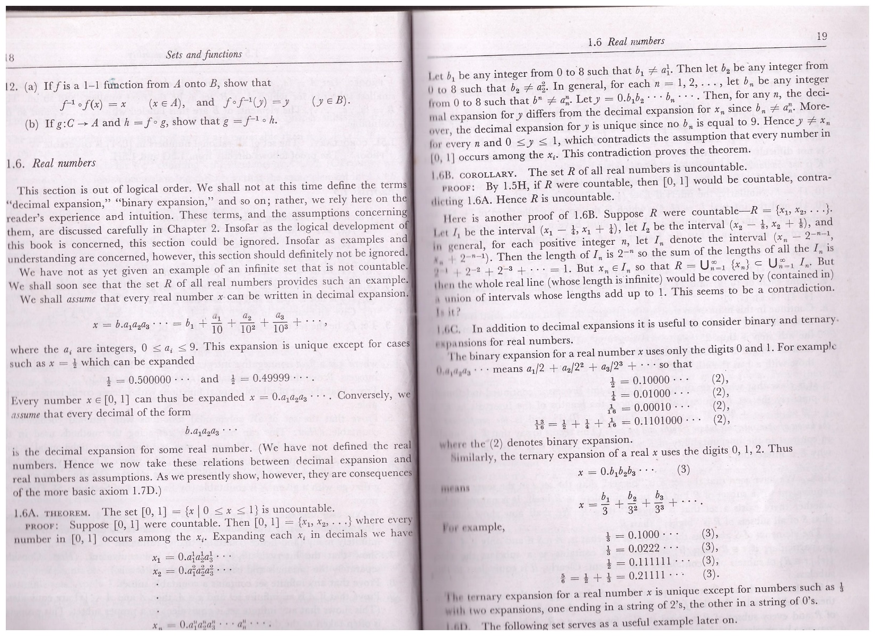

Slide 13
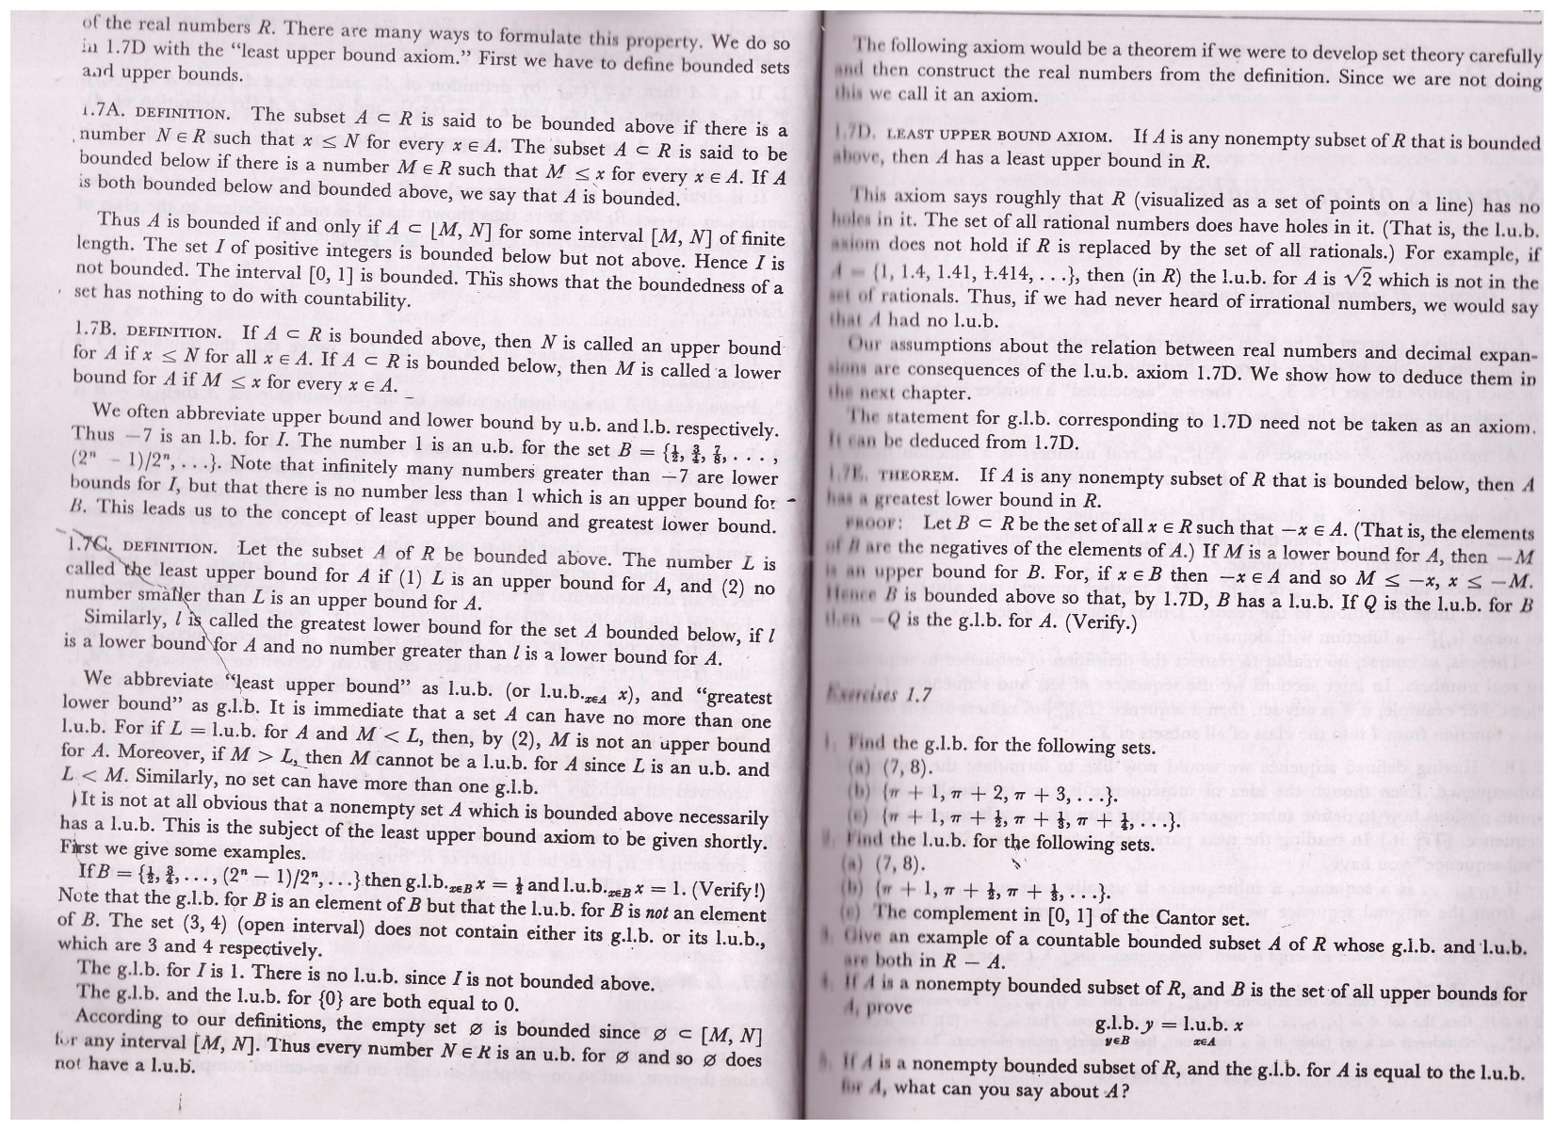

Slide 14
THANK YOU

